Slide 1
Project 7: Parking Spaces Occupancy Prediction
Zoe Hite, Brian Aguilar, Tejas Shetty, Atul Balaji, Vihaan Ambre
CS4624: Multimedia & Hypertext Capstone

Slide 2
Outline
Problem | Breaking down the why of our project
System Deployment | Getting the project to run
Updates | VT Parking Services (data) Machine Learning (ML)
Features | Requirements of the project
Frontend | Redesign objectives
Timeline/Milestones | Updated plan for the future
Acknowledgements/ References | Resources used for this project

Slide 3
Problem Recap
Currently, Virginia Tech’s parking lot situation leads to the following:
Parking scarcity leads to drivers wasting considerable time
Drivers may make uninformed decisions based on static parking availability information
No real-time updates for parking lot availability
Our project aims to improve upon these key points

Slide 4
System Deployment
Following the developer manual provided by the previous group, we were able to get the project running
Issues Encountered:
Model - required training to ensure program could run successfully
Frontend - functionality not performing as expected
Developer Instructions - lacked necessary steps for setup and execution

Slide 5
VT Parking Services
Spoke to Aaron Judy, Operations Systems Analyst, from VT Transportation Services
No existing logged data
Visited Blacksburg Town Hall
No helpful logged data
Will continue to train and deploy project with pre-existing datasets from JMU

Slide 6
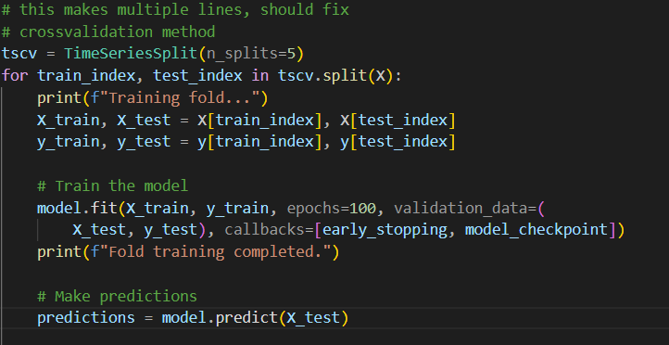
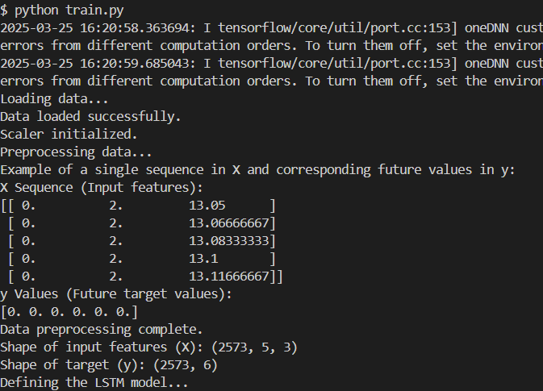
The ML Model
train.py and prediction.py
Time-based data extracted
Long Short-Term Memory (LSTM) a recurrent neural network process

Slide 7
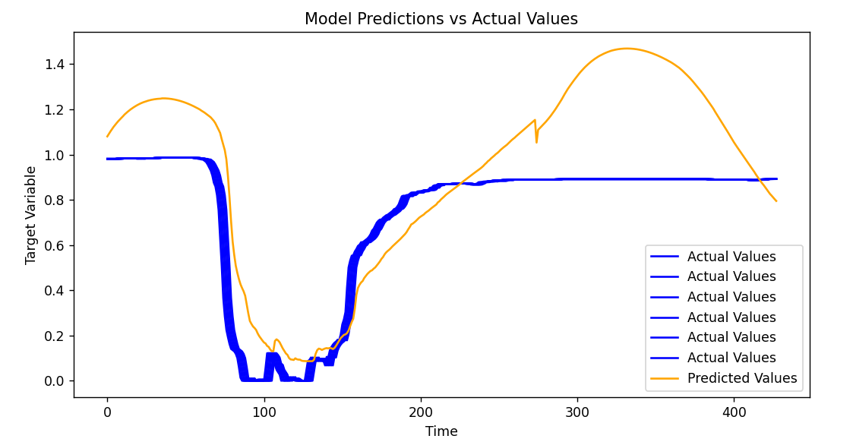
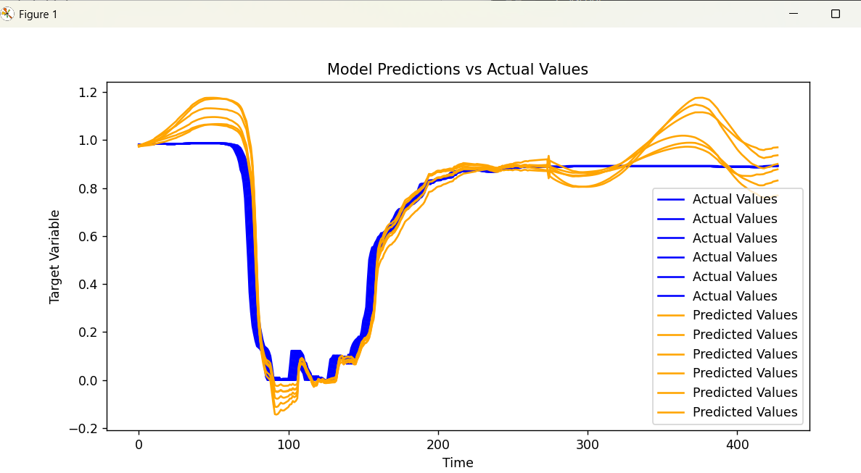
Time Series Forecasting
# time series forecasting
forecast_horizon = 1
# time series forecasting
forecast_horizon = 6

Slide 8
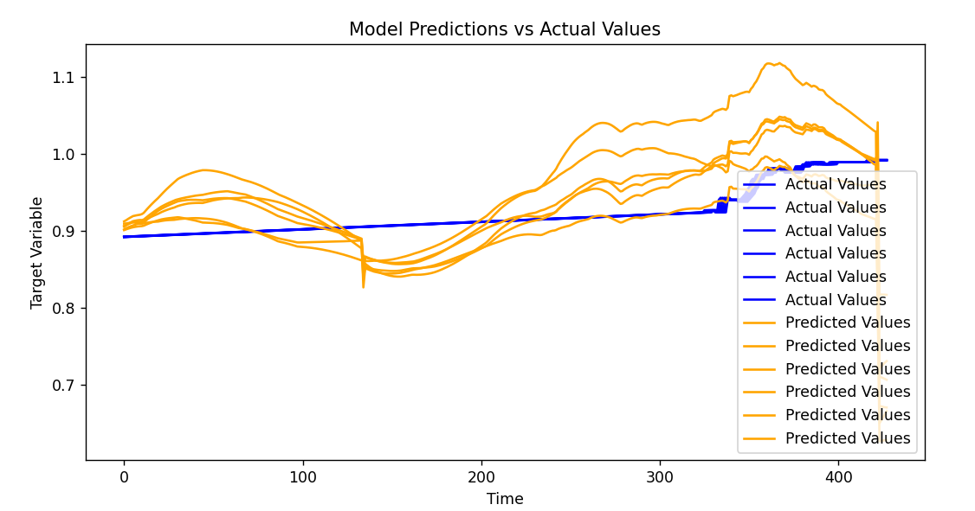
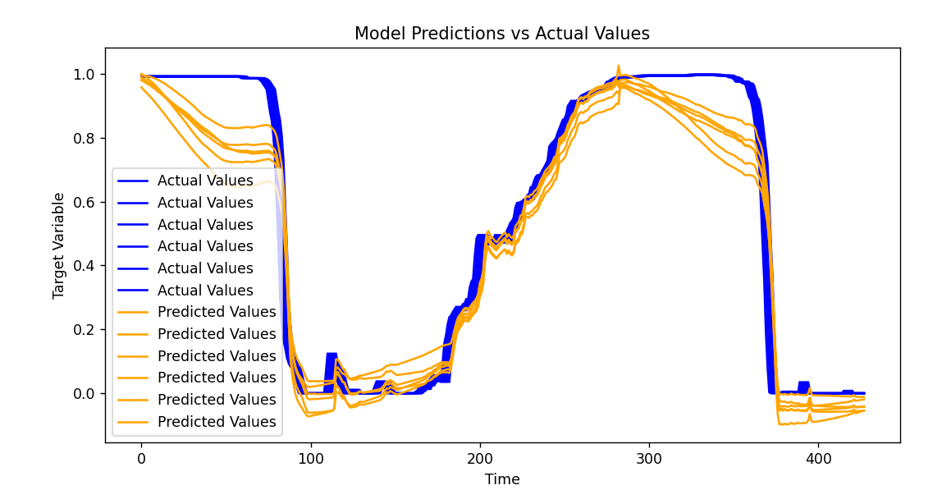
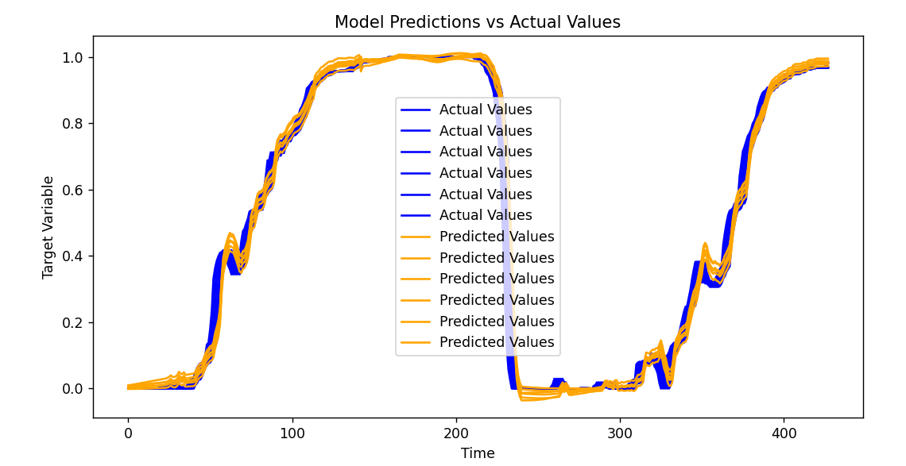
Training the Data
-produced folds (iterations of training and testing)
-trained data is passed into backend

Slide 9
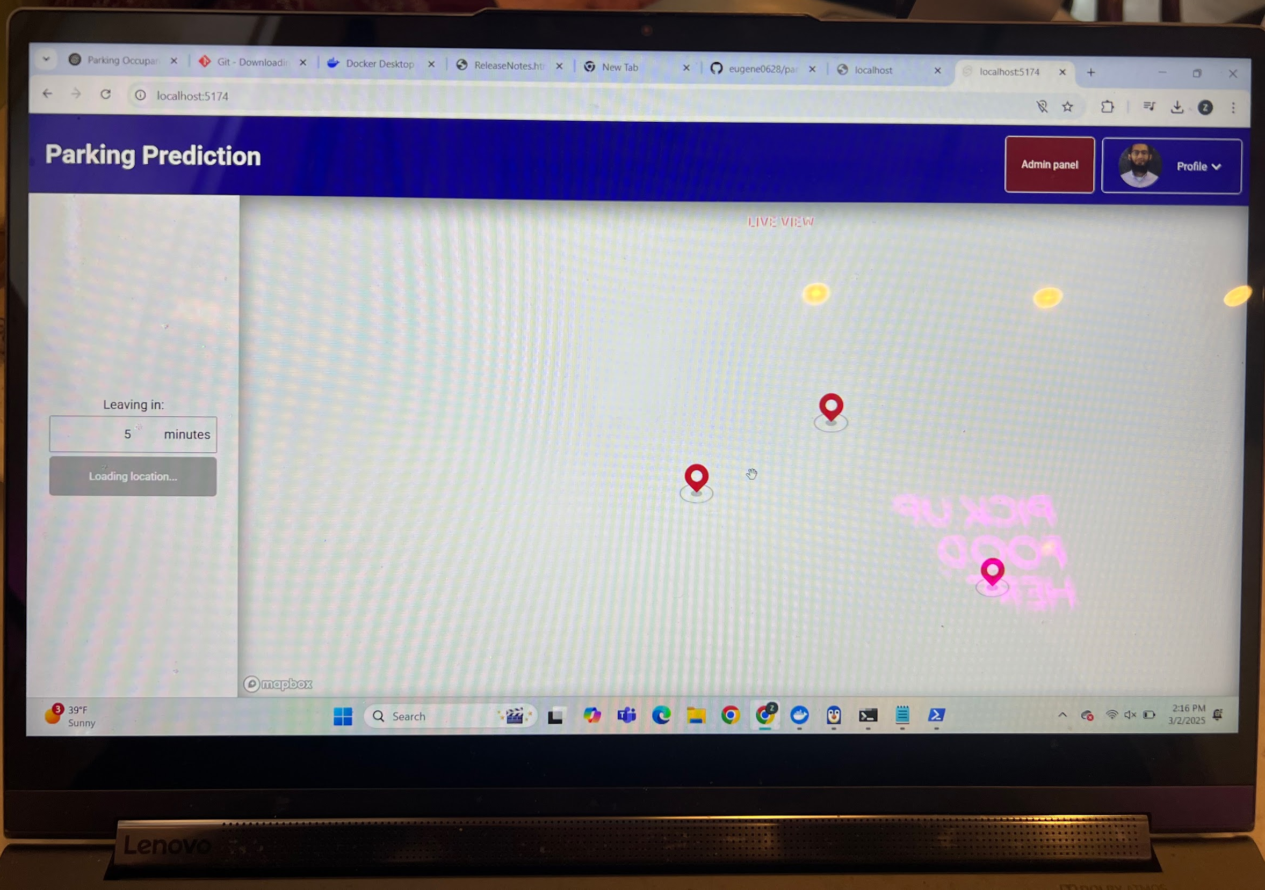
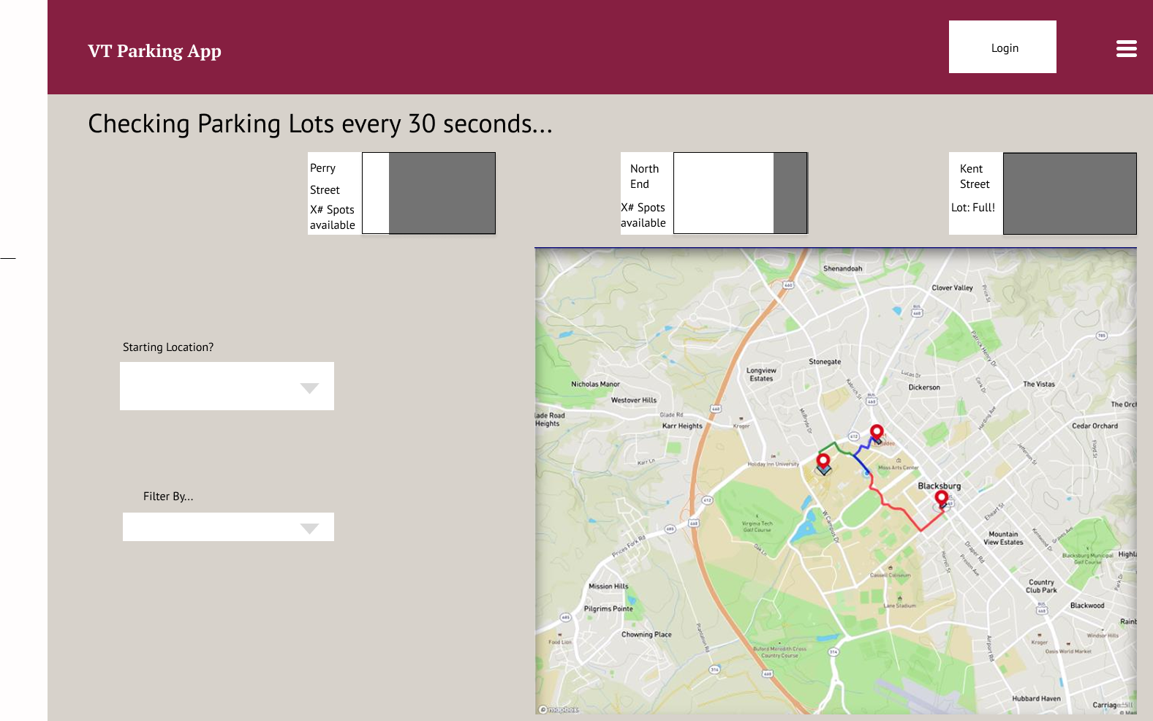
Frontend
Notes:
Tejas: The current Frontend implementation doesn’t seem to be operating at full functionality. The current state doesn’t display the map of blacksburg. Suspecting this to be an issue with Flask. We realized a full redesign of the frontend was needed. Basic features such as a login will be the first step.

Slide 10
Features
Machine Learning Model
Time Series Graph with time series casting
Blacksburg Map
Filter System (Dropdown menu)
Nearest parking garage
Shortest distance
Garage with the most available parking spots
Login
Admin panel to see sessions of other users.
Notes:
Tejas:

Slide 11
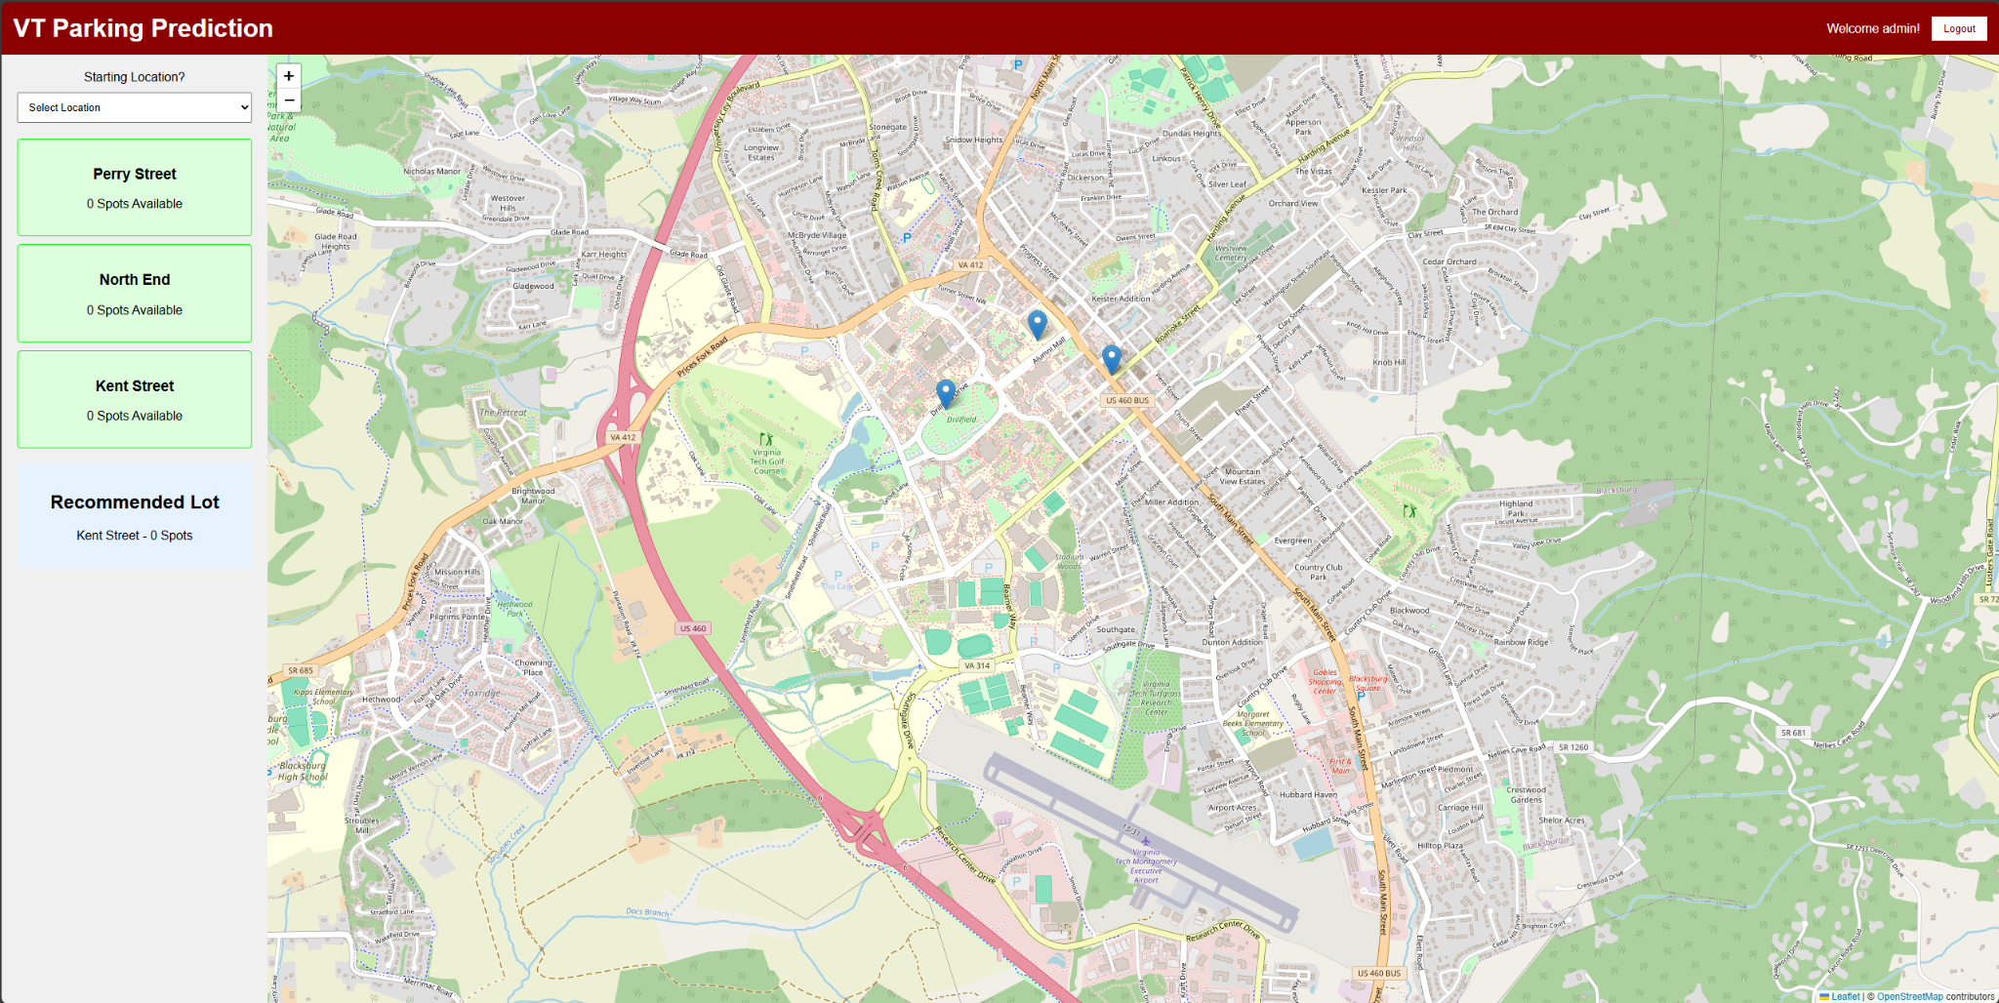
Current Frontend
Notes:
Much more cleaner UI. The things that need to be refined are the drop down menu and maybe adding some admin tools such as viewing the data that is processed in live time. The current implementation hasn’t been linked to our backend as of yet.

Slide 12





System Architecture
Next steps:
Biggest obstacle is getting Flask to run after retraining the data
Begin testing the UX/UI using React
React
Flask

Slide 13
Current Timeline
1/28 - 2/3
2/4 - 2/10
2/11-2/18
2/19- 3/5
3/6-3/17
3/18-4/5
Milestone 1
Milestone 2
Milestone 3
Milestone 4
Milestone 5
Milestone 6
Review the Project Launch page, schedule an appointment with the Client, delegate tasks, and appoint a team leader
Identify potential datasets (contact Virginia Tech Parking Services), meet with client, establish novelties
Research previous projects, summarize findings, display information on project presentation, finalize timeline
Finalize dataset selection,
Begin initial ML model development (data preprocessing, feature selection)
Train a baseline ML model, evaluate initial results & refine approach
Debug the API to interact with the ML model, test API with sample requests, set up and integrate database for parking data storage
.

Slide 14
Current Timeline Cont.
4/6 - 4/10
4/11 - 4/17
4/18 - 4/24
4/25 - 5/2
Milestone 7
Milestone 8
Milestone 9
Milestone 10
Develop UI wireframes/mockups,
build a working prototype with dummy data
Connect ML model, API, database, and frontend
Conduct unit and integration testing
Optimize model performance and database queries
Finalize user & developer manuals
Prepare final project demo

Slide 15
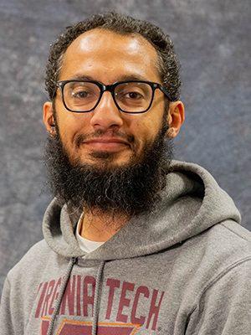
Acknowledgements
Client
Mohamed Farag
mmagdy@vt.edu
Instructor
Dr. Farag
mmagdy@vt.edu

Slide 16
References
James Jang, Nam Tran, Drew Loomis, Avi Mehta, Bowen Lin. (April 2023). Smart Parking Recommender Mobile Application. Report. Retrieved from Virginia Tech VTechWorks.
https://vtechworks.lib.vt.edu/items/3ad329e0-be66-4b62-b1d0-29646f88ba1f
Mohamed Farag, Josh Marcelin, Adi Hanumaiah, Antonio Lau, Kevin He, Eugene Kwon. (November 2023). Parking Spaces Occupancy Prediction. Report. Retrieved from Virginia Tech VTechWorks.
https://vtechworks.lib.vt.edu/items/d313d723-23ad-441d-9662-3bcc8cbed52c
Mohamed Farag, Amr Hilal, Samy El-Tawab. Parking Occupancy Prediction and Traffic Assignment in a University Environment. Report. Retrieved from professor.

